Slide 1
Public Health Alliance Presents:
Standing Eight Movie Premiere and Lupus Discussion
Featuring Dr. Edith Williams

Slide 2
Edith M. Williams, PhD, MS
Associate Professor at the Medical University of South Carolina
Department of Public Health Sciences
Department of Medicine, Division of Rheumatology
Core Investigator, MUSC Center for Health Disparities Research

Slide 3
Let’s Watch the movie

Slide 4
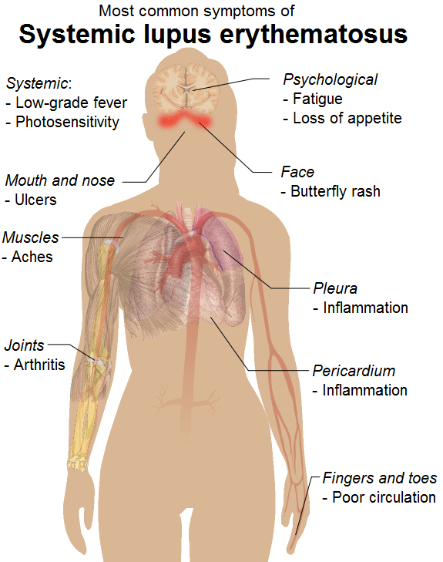
Let’s Talk About Lupus...
What is systemic lupus erythematosus and how does it
affect the body?
Who is at risk?
How common is the disease?
How do you know if you have lupus?
What is challenging about this disease?
What are treatment options for those diagnosed with lupus?
Where can we find more information and resources pertaining to lupus?

Slide 5
Thank You for coming to our event!

